Slide 1
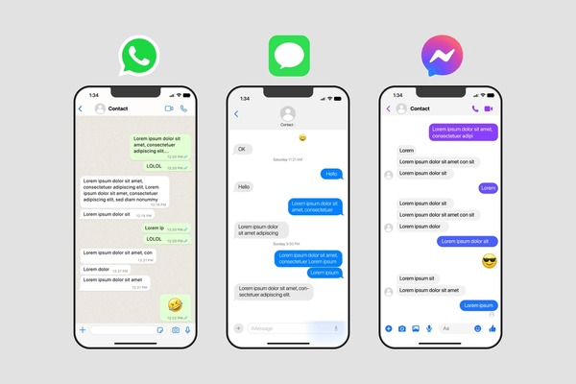
Distributed Chat Application
A peer-to-peer style chat system with reliability, history, and auto-reconnection
Adhithya Veeramalai Manickam
Jason Joshuva J
Shobiha S
Thamarai Selvan S

Slide 2

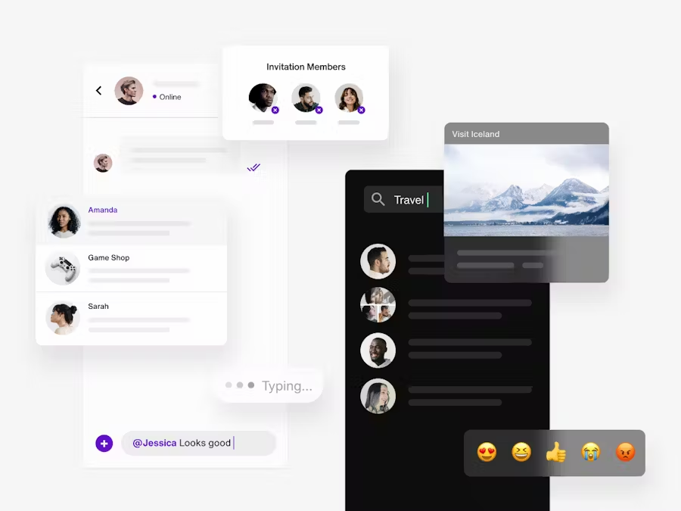






Project Overview
Goal
Peer-to-peer style chat with reliability and message history
MVP Features
Server accepts multiple clients (concurrency)
Clients send/receive broadcast messages
Server keeps message history for new clients
Client auto-reconnects if connection drops
Advanced Features
Leader Election
Message Replication
Persistent Storage
Chat Rooms
Private Messages
TLS Security

Slide 3



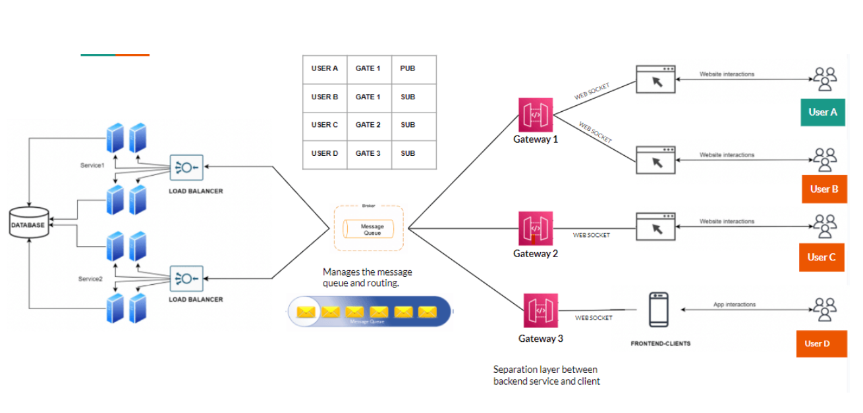








Architecture
System Design
Central Server
Manages connections, broadcasts messages, maintains history
Multiple Clients
Send/receive messages, auto-reconnect on failure
Message Flow
Client Sends
Server Broadcasts
All Clients Receive
Key Components
Message history (last N messages)
Heartbeat mechanism (keep-alive)
Auto-reconnection logic

Slide 4


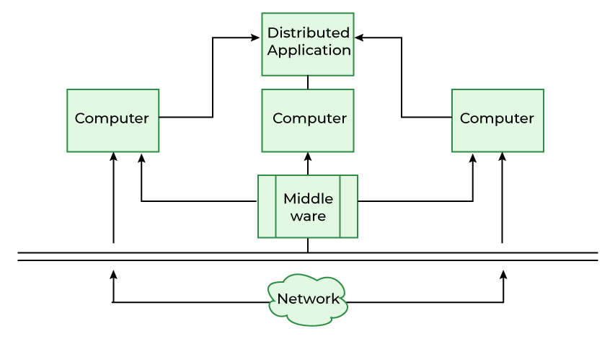








Tech Stack
Python 3.10+
Threading
Core language for implementation
Concurrency handling
JSON
Socket
Message serialization
Network communication
Future Enhancements
SQLite
File Storage
Docker
TLS/SSL
Asyncio

Slide 5
















Advanced Features
Multi-Server Architecture
Persistence & Durability
Implement leader election and message replication for high availability
Store messages for long-term retention and recovery
Bully algorithm for leader election
Append-only log for message storage
Message replication to backup servers
Periodic fsync for durability
Automatic failover when leader fails
Integration with HDFS for scaling
Enhanced Chat Features
Security & Deployment
Add more functionality for richer user experience
Secure communication and scalable deployment
Chat rooms with topic-based channels
TLS/SSL encryption for all traffic
Private messaging between users
Authentication with tokens or passwords
File sharing capabilities
Docker containerization for deployment
JOIN_ROOM
PRIVATE_MSG
FILE_TRANSFER
Rate Limiting
Docker Compose
Kubernetes

Slide 6













Conclusion
Key Achievements
Future Directions
Leader Election - Implement Bully algorithm for fault tolerance
Multi-client support
Message history
Persistent Storage - Append-only log with HDFS integration
Security - TLS encryption and user authentication
Auto-reconnection
Heartbeat mechanism
Containerization - Docker deployment with Kubernetes
Challenges & Solutions
Our distributed chat application demonstrates how simple components can create a robust, scalable system with proper architecture and design patterns.
TCP Stream Framing
Solved with length-prefix framing in common.py
— Team Adhithya, Jason, Shobiha, Thamarai
Thread Safety
Implemented with threading.Lock() for shared resources

